Slide 1
MLPerf
Lessons Learned

Slide 2
What is MLPerf?
Advice for groups wanting to create new benchmarks.

Slide 3
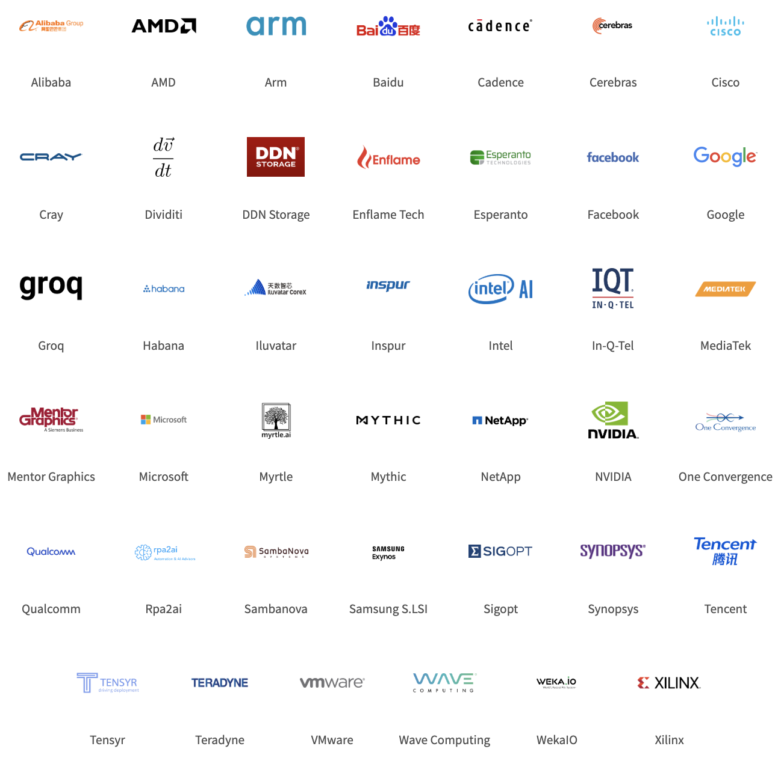
What is MLPerf?
A machine learning
performance benchmark suite
with broad industry and academic
support.

Slide 4
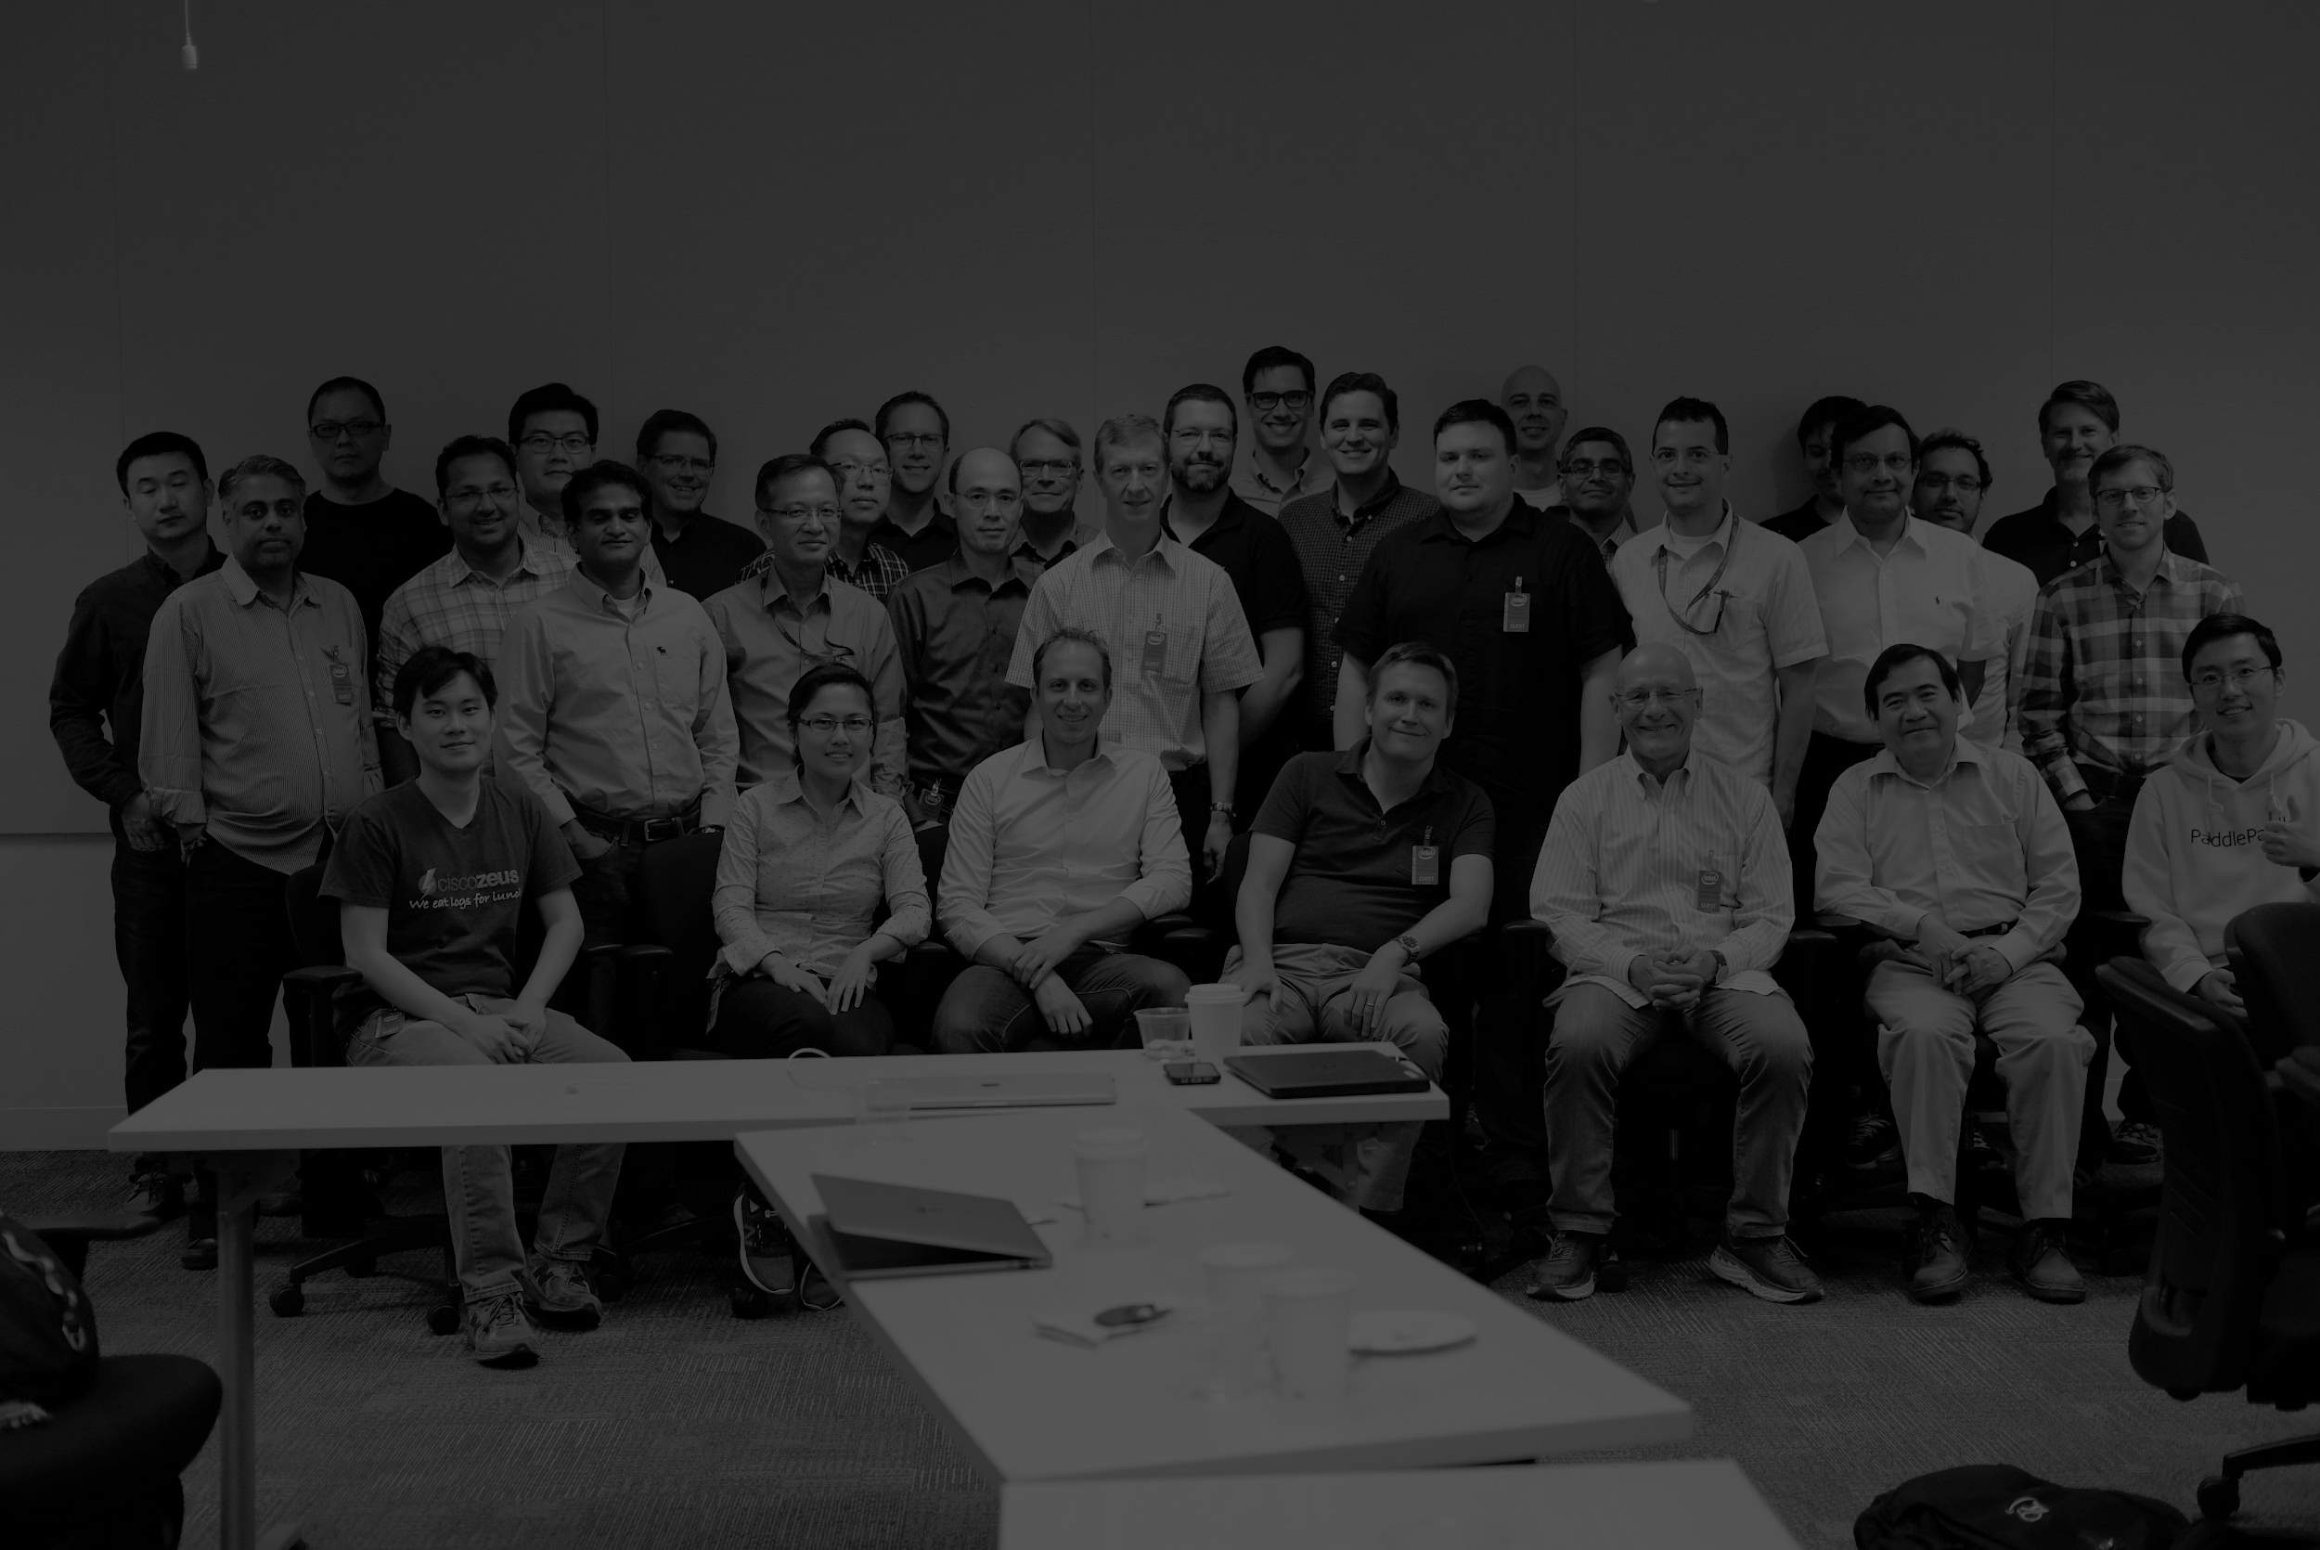
MLPerf is the work of many
Founding leads: Peter Bailis (Stanford), Greg Diamos (Baidu), Peter Mattson (Google), David Patterson (UC Berkeley / Google), Gu-Yeon Wei (Harvard), Matei Zaharia (Stanford)
Training chairs: Victor Bittorf (Google), Paulius Micikevicius (NVIDIA), Andy Hock (Cerebras)
Inference chairs: Christine Cheng (Intel), David Kanter (RWI), Vijay Reddi (Harvard), Carole-Jean Wu (Facebook), Guenther Schmuelling (Microsoft), Hanlin Tang (Intel), Bing Yu (MediaTek)
Many others see mlperf.org/about

Slide 5
Why benchmark machine learning?
ML hardware is projected to be a ~$60B industry in 2025. (Tractica.com $66.3B, Marketsandmarkets.com: $59.2B)
“What get measured, gets improved.” — Peter Drucker
Benchmarking aligns research with development, engineering with marketing, and competitors across the industry in pursuit of a clear objective.

Slide 6
ML benchmark design overview
Big Questions | Training | Inference
1. Benchmark definition | What is a benchmark task?
2. Benchmark selection | Which benchmark tasks?
3. Metric definition | What is performance?
4. Implementation equivalence | How do submitters run on very different hardware/software systems?
5. Issues specific to training or inference | Which hyperparameters can submitters tune? | Quantization, calibration, and/or retraining?
 | Reduce result variance?

Slide 7
Training benchmark definition
Dataset
Target Quality*
E.g. ImageNet
Train a model
E.g. 75.9%
* Target quality set by experts in area, raised as SOTA improves

Slide 8
Training benchmark selection
Vision | Speech | Language | Commerce | Research
 |  | ~~~~~~~~~ ~~~~~~~~~~~ ~~~~~~~~
Image classification Object detection / segmentation Video Medical imaging | Speech to text Text to speech | Translation Language modeling | RecSys Time series | Reinforcement learning -- games Reinforcement learning -- robotics GANs
$$$

Slide 9
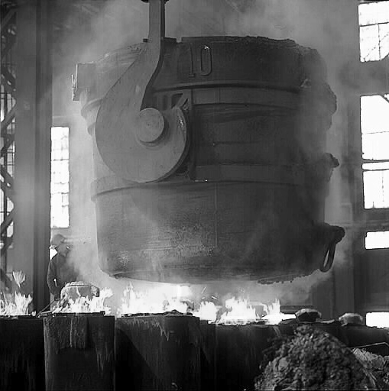
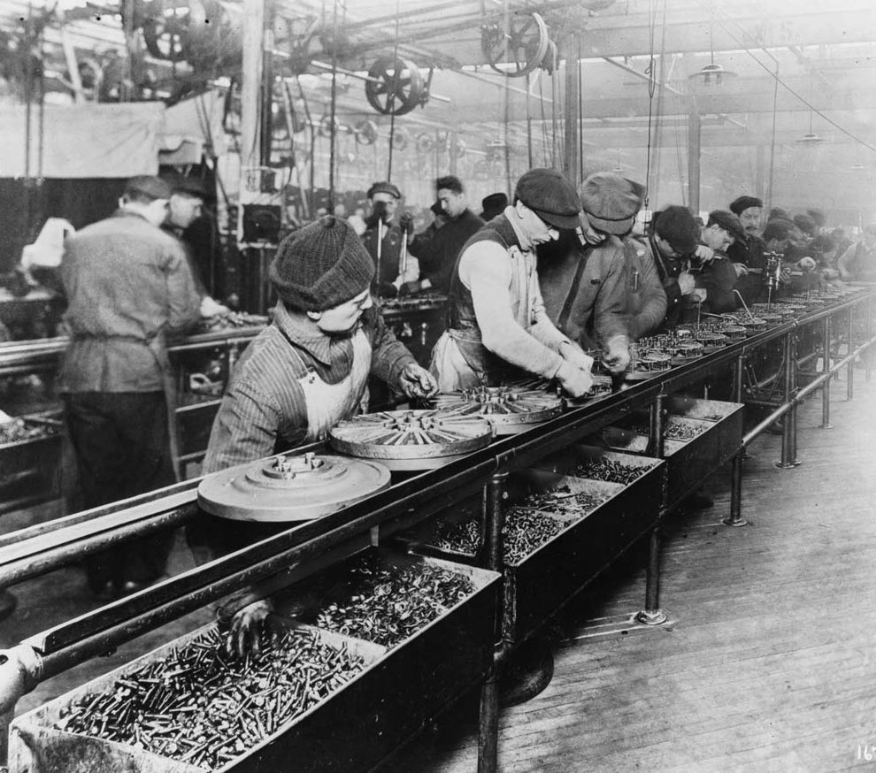
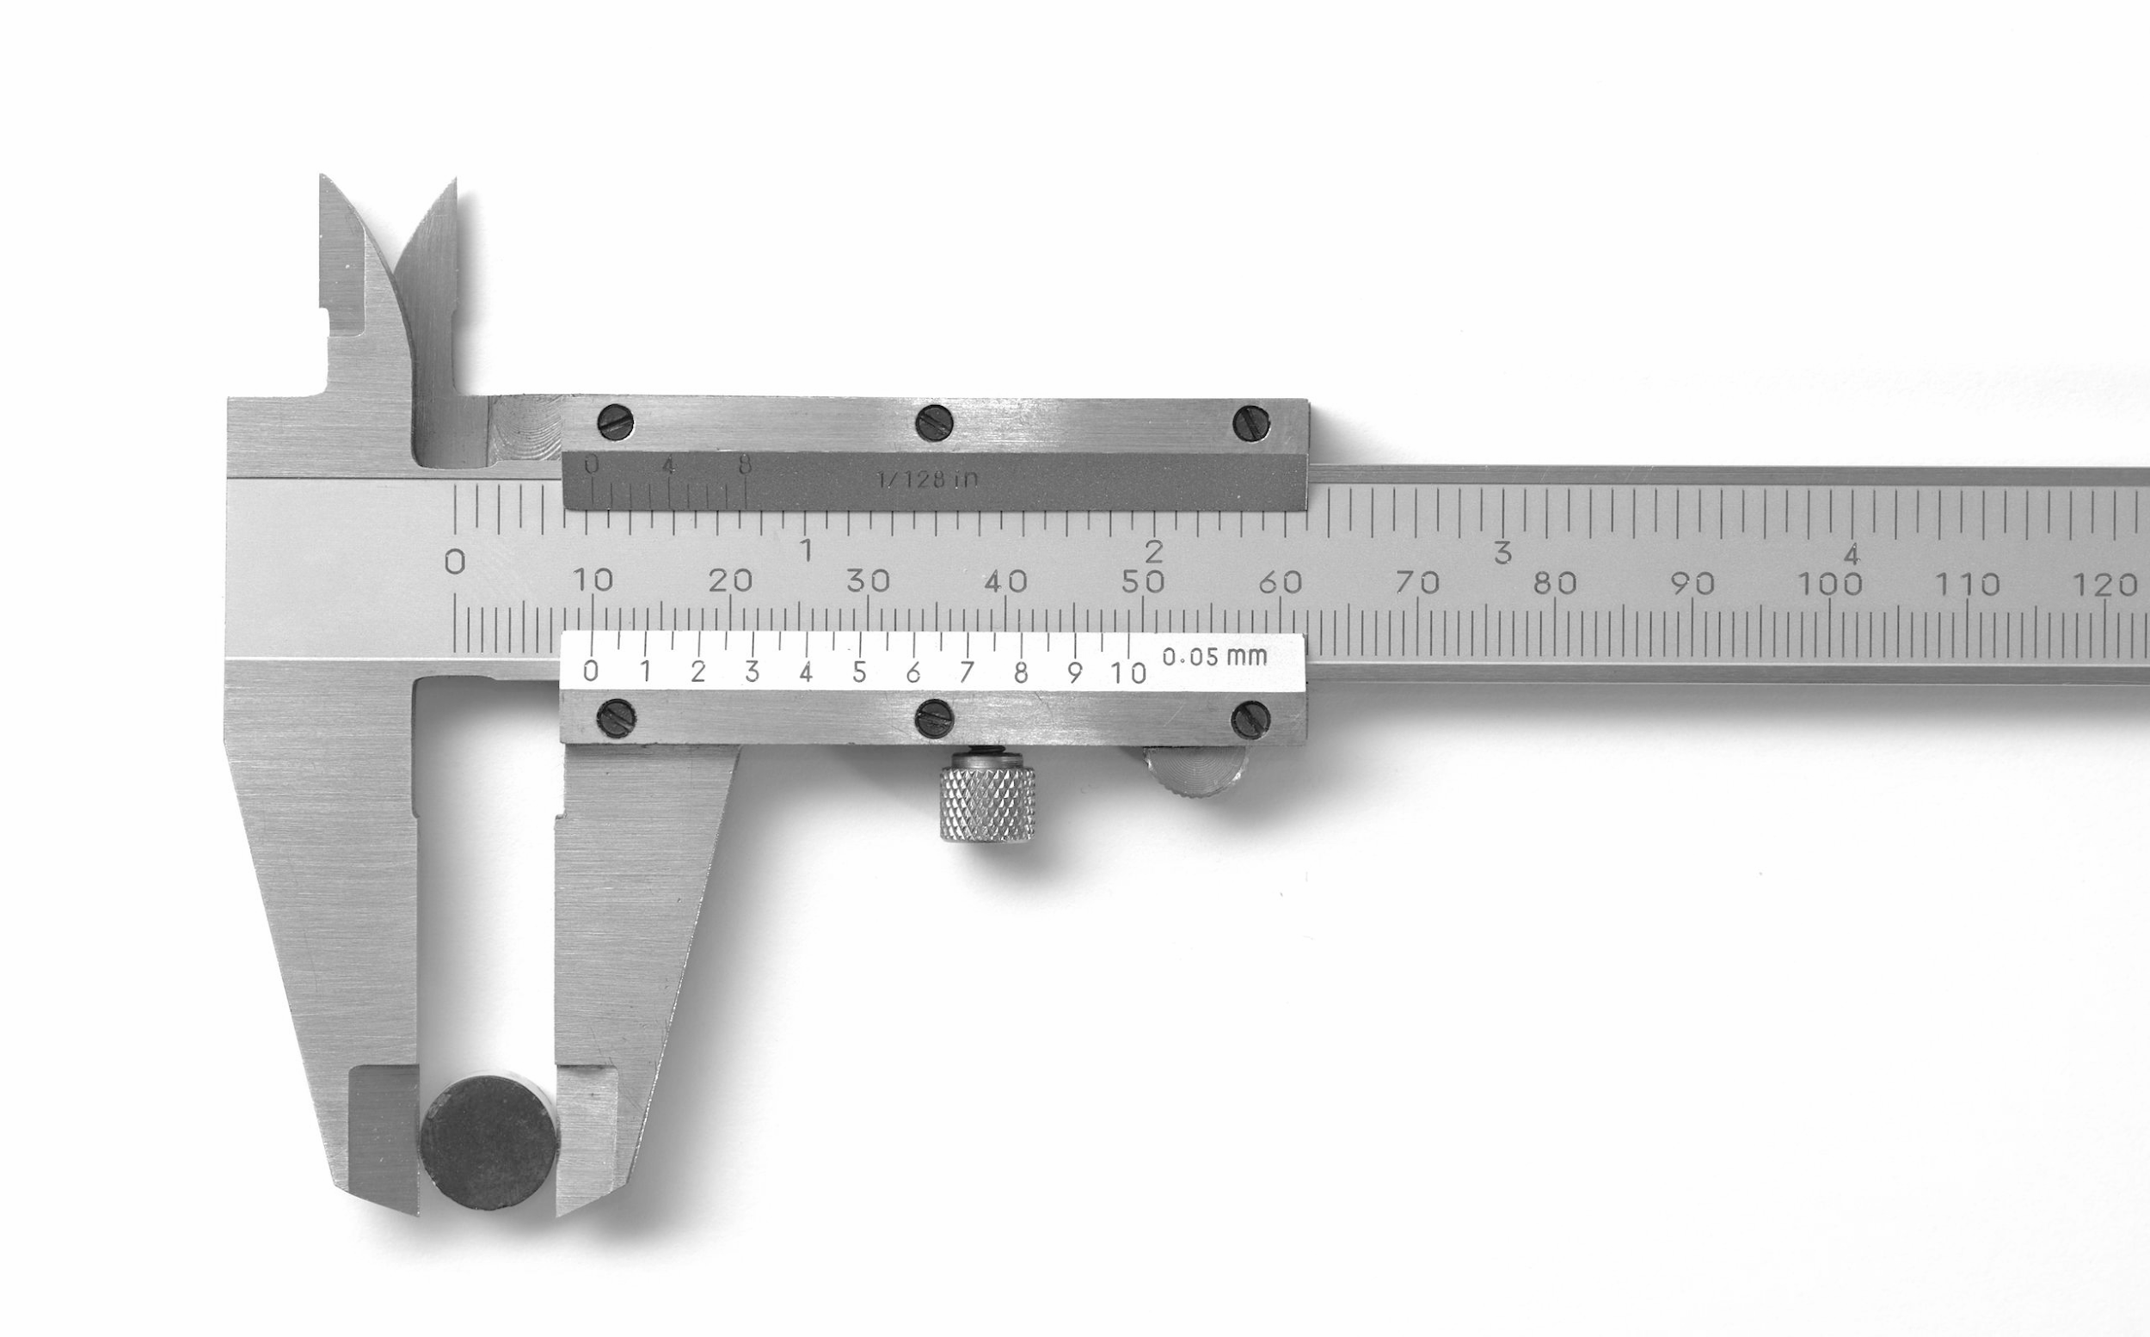
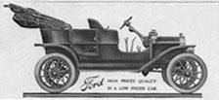
Home of MLPerf: MLCommons
We created a non-profit called MLCommons to “accelerate ML innovation and increase its positive impact on society.”
Benchmarks
+
Large public
datasets
+
Best practices
+
Outreach
Photo credits (left to right): Simon A. Eugster CC BY-SA 3.0, Riksantikvarieämbetet / Pål-Nils Nilsson CC BY 2.5 se, Public Domain, Public Domain

Slide 10
Lessons learned
Think long term
Industry already knows how to build benchmarks
Agile benchmarking
Metrics matter, and require insight
Grudging consensus

Slide 11
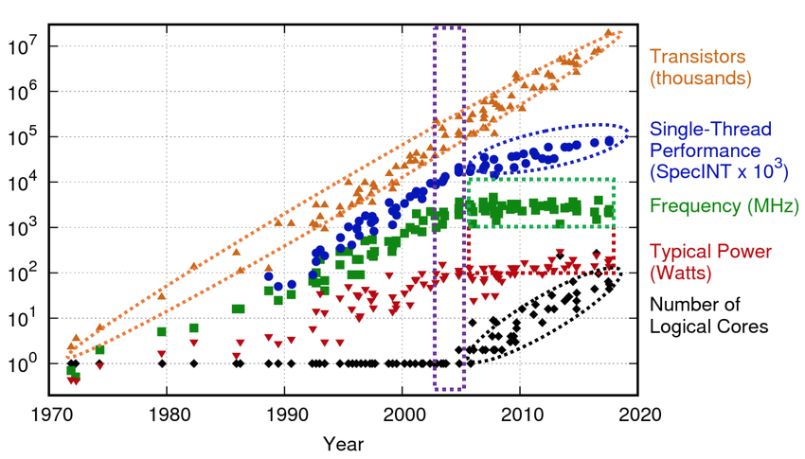
Think long term
Progress takes a long time
But it compounds
10,000x faster SPECint in 40 years

